Slide 1

BIO727P
Bioinformatics Software
Development Group Project
Team Liam
Vi Bui, Uppy Gill, Liam Johnson, Neha Khairnar
Tutorial – 10th February 2022

Slide 2
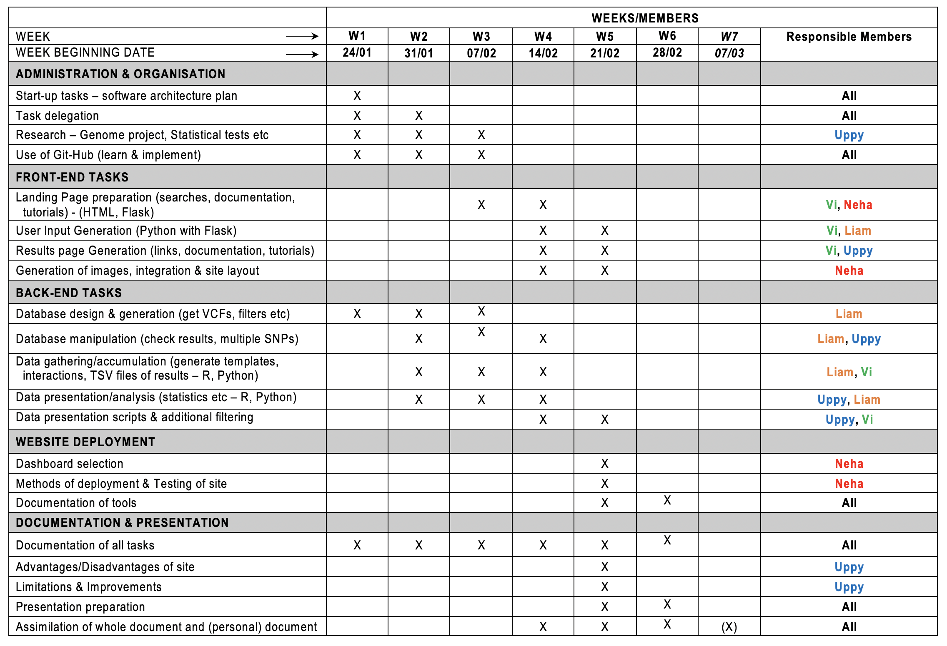
Project Plans
SNPEuro Portal

Slide 3
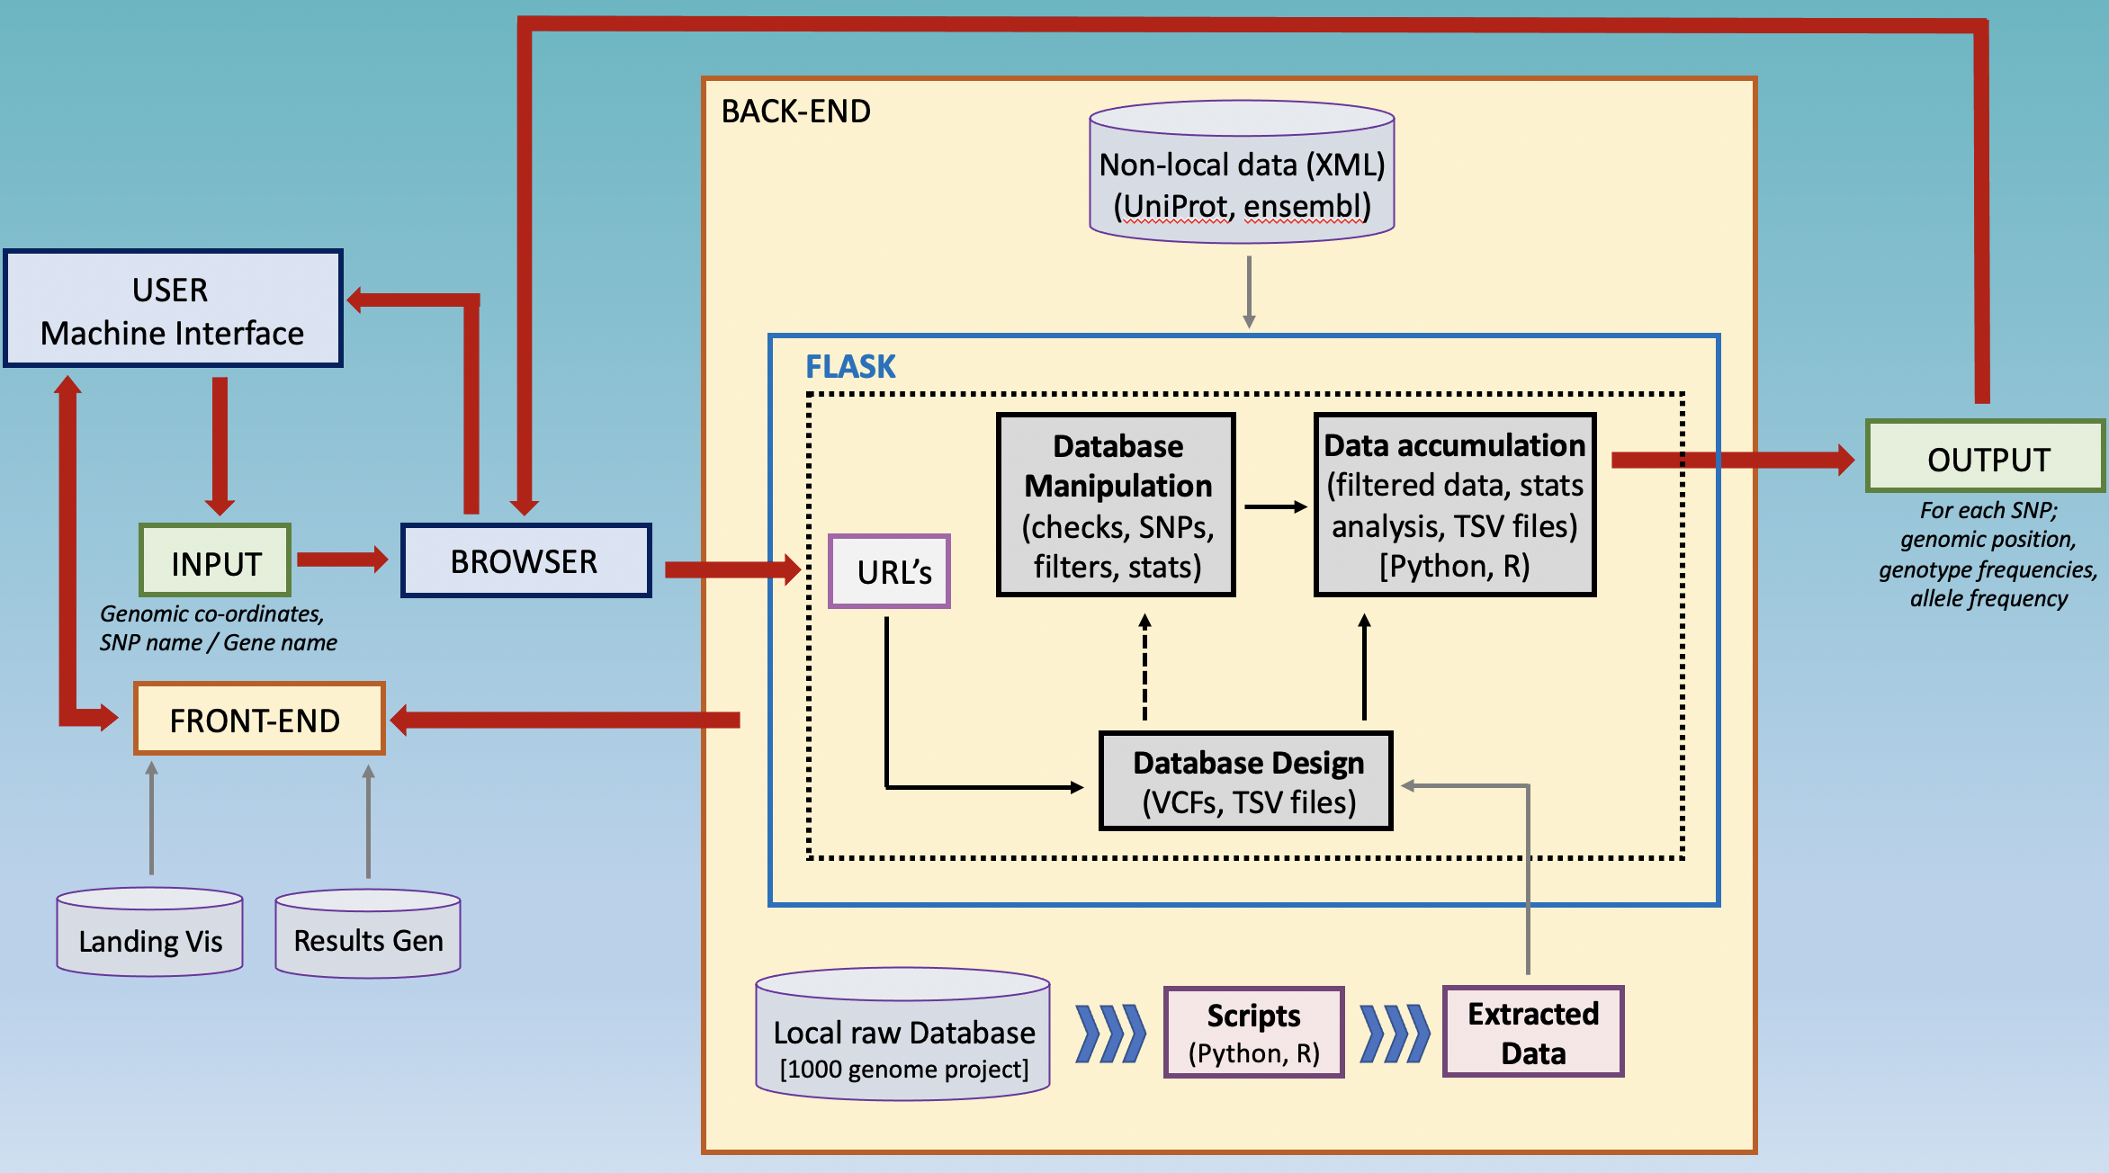
Software architecture
SNPEuro Portal

Slide 4
Demonstration
Front-End (Flask)
SNPEuro Portal

Slide 5
Demonstration
Database Preparation
SNPEuro Portal

Slide 6
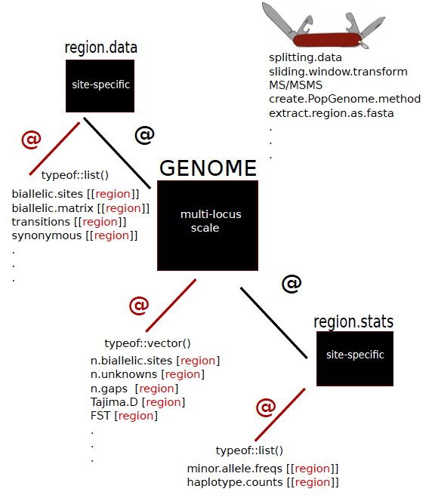
Statistical Tests
PopGenome Package
- Rstudio
- Use rpy2 for ‘link’ to Python
Package for population genomic analyses & method development
Includes diversity, neutrality and polymorphisms stats
Applied to whole genome SNP data
SNPEuro Portal

Slide 7
Statistical Tests
PopGenome Package
Diversity Statistics
diversity.stats.between-methods
Function to calculate nucleotide & haplotype diversities between populations
F_ST.stats-methods
Fixation index
Calculates nuc diversity within nucleotide & hap diversity within haplotype
Nucleotide diversities divided by size of region – diversities per site
SNPEuro Portal

Slide 8

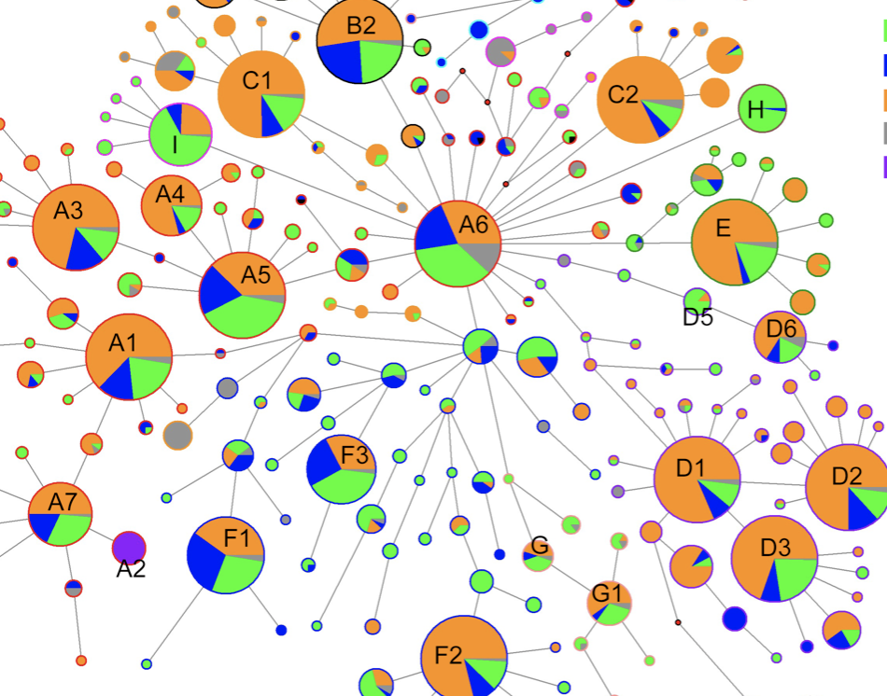
Statistical Tests
PopGenome Package
Diversity Statistics
Nucleotide Diversity (Genetic diversity)
Haplotype Diversity
SNPEuro Portal

Slide 9
Statistical Tests
PopGenome Package
Neutrality Statistics
Neutrality.stats-methods
Function to calculate neutrality statistics
Tajima’s D
Difference between 2 measures of genetic diversity
Distinguishes between a DNA sequence evolving randomly (‘neutrally’) and one evolving under a non-random process
A negative result signifies excess of low frequency polymorphisms relative to expectation (population size expansion)
A positive result signifies low levels of both low and high frequency polymorphisms, indicating a contraction in population size and/or balancing selection.
SNPEuro Portal

Slide 10
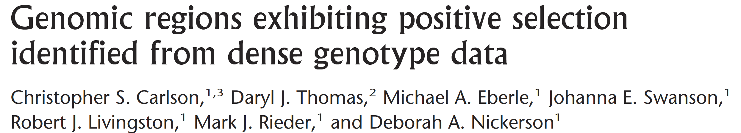
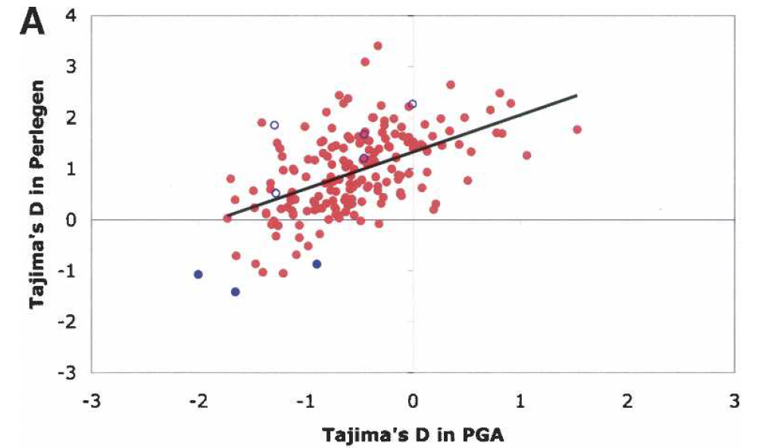


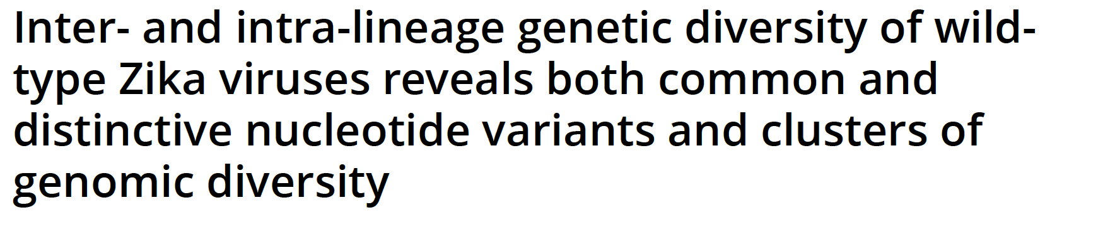

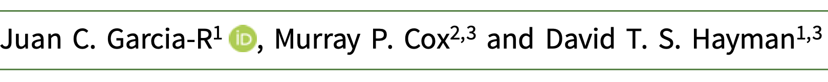

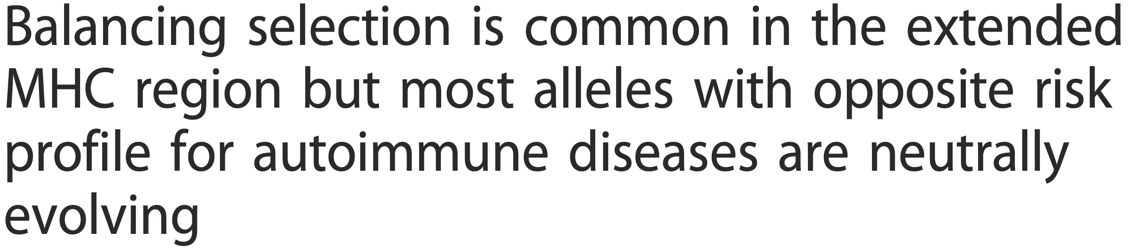
Statistical Tests
SNPEuro Portal

Slide 11
Demonstration
Statistical Tests
SNPEuro Portal

Slide 12
Plans for next week
Completion of final database with populations
Filter database, relative to requirements for statistical tests
Complete sliding window
Use rpy2 for linking statistical code to flask – website
Website updates (genomic co-ordinates)
Documentation
SNPEuro Portal

Slide 13


